Slide 1
Enterntainment Exploration
Target Demographics and Goals

Slide 2
GOALS
What are some traits we can glean from some basic movie and TV show data?
How can we optimize movie and TV show decisions to generate revenue
Utilizing IMDB and TMDB score as sign of “successful movie/show”
Looking at various demographics
Look at successful movies and TV shows

Slide 3
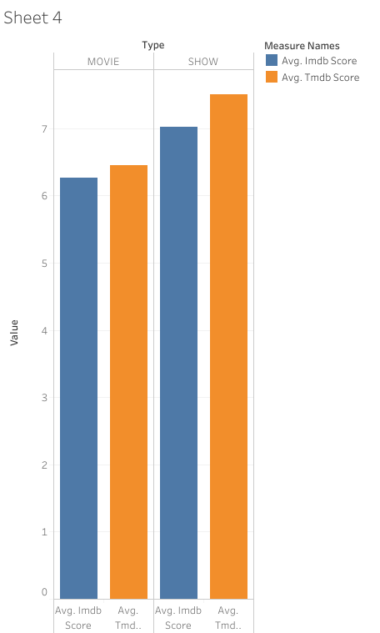
Movies vs TV

Slide 4
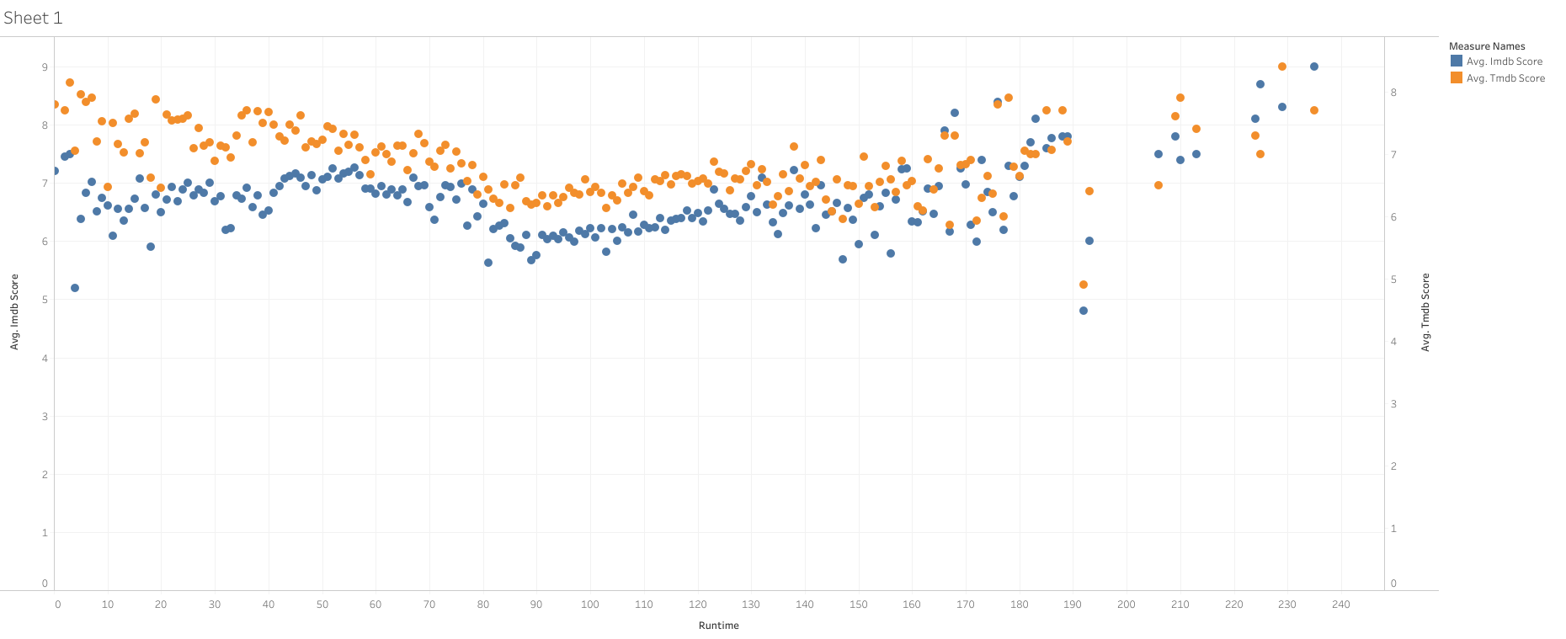
Runtime vs IMDB Score
No significant change in score with increasing run time

Slide 5
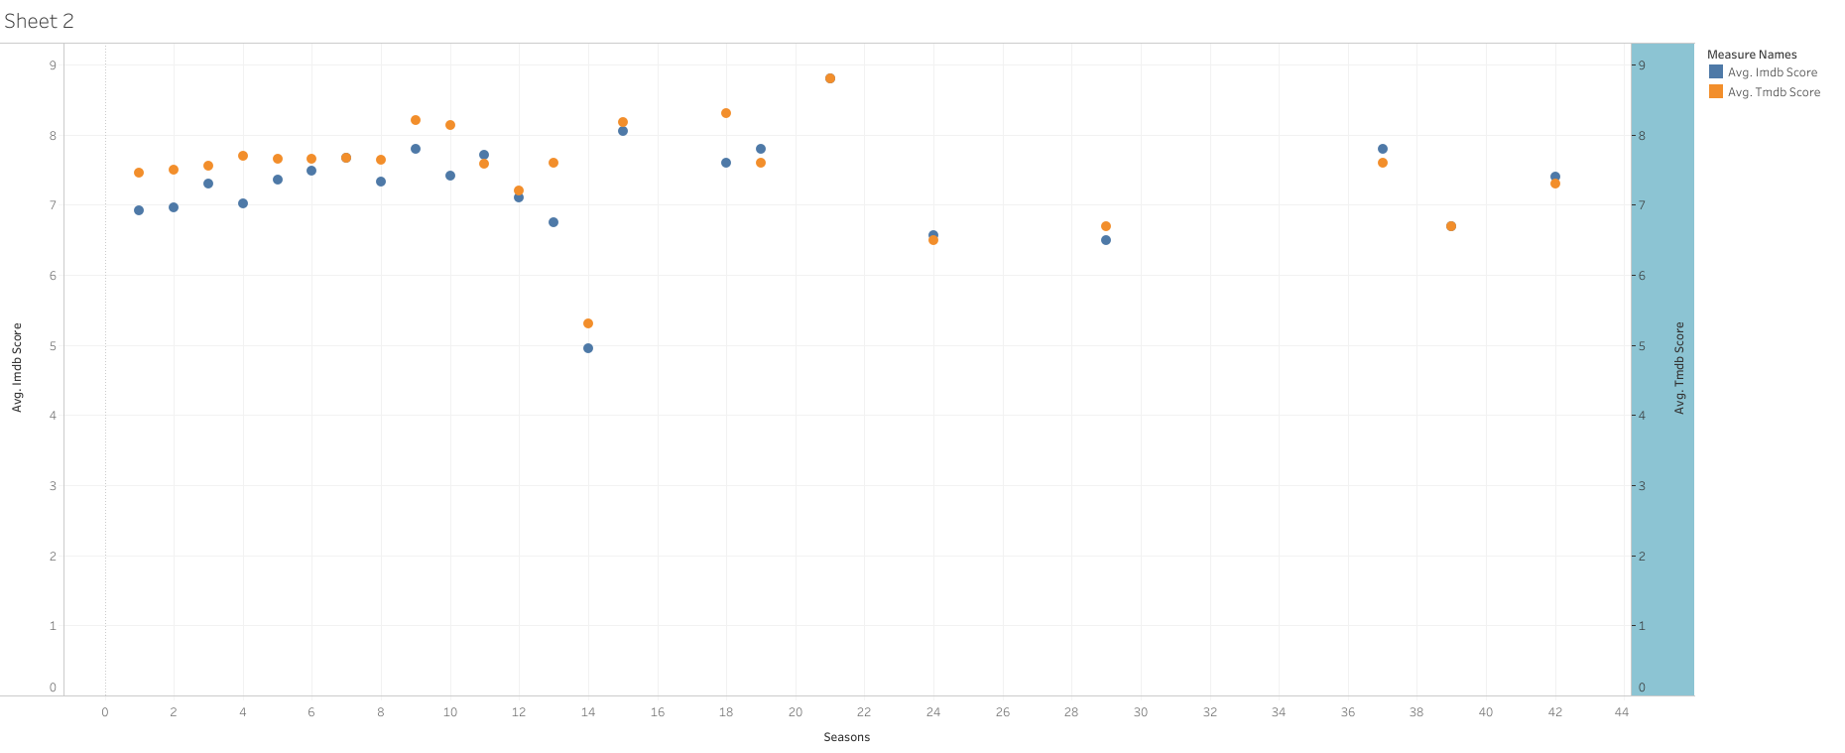
TV Show Seasons
For some reason shows with 14 seasons have a significantly lower score
Shows with 10-12 seasons have good success

Slide 6
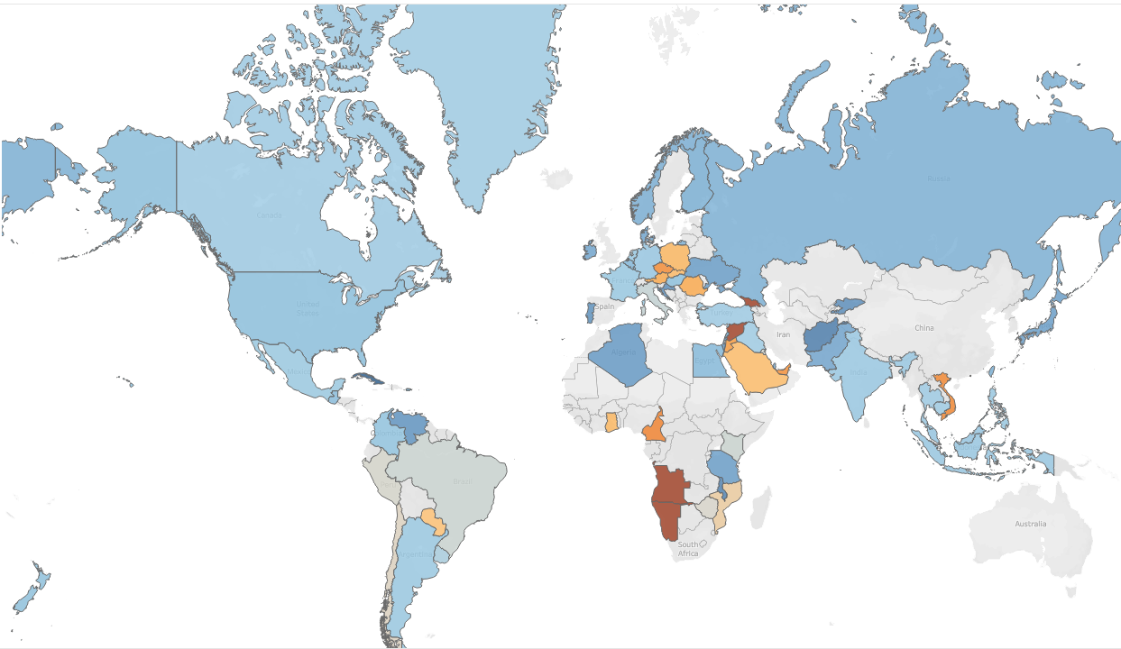
Scores by Country
TV shows and movies do not suffer based on their country of origin

Slide 7
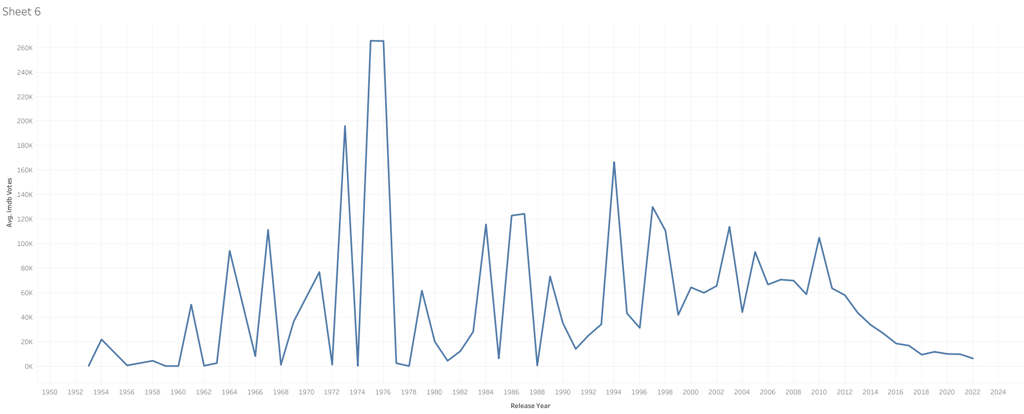
IMDB Ratings over time
Movies in the 70s are particularly popular as shown by their large amount of ratings
Probably due to the generational

Slide 8
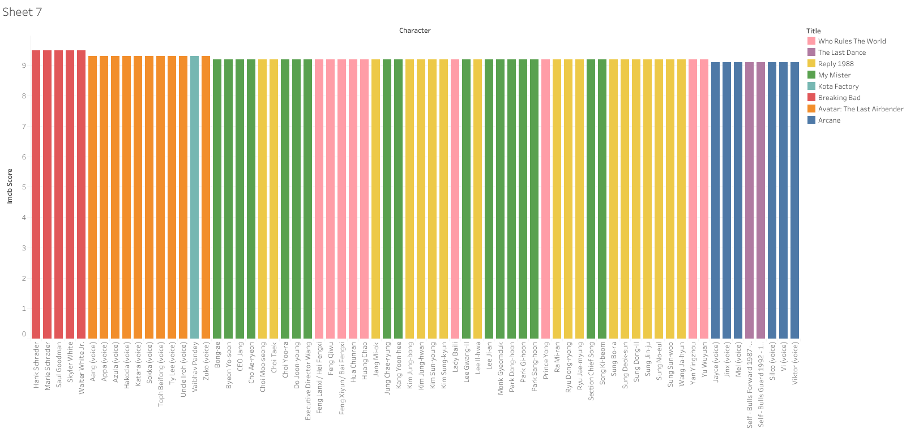
Top characters and their titles
These are the top characters
More importantly, their titles are on the right
These are all TV shows, might be useful to look at their success

Slide 9
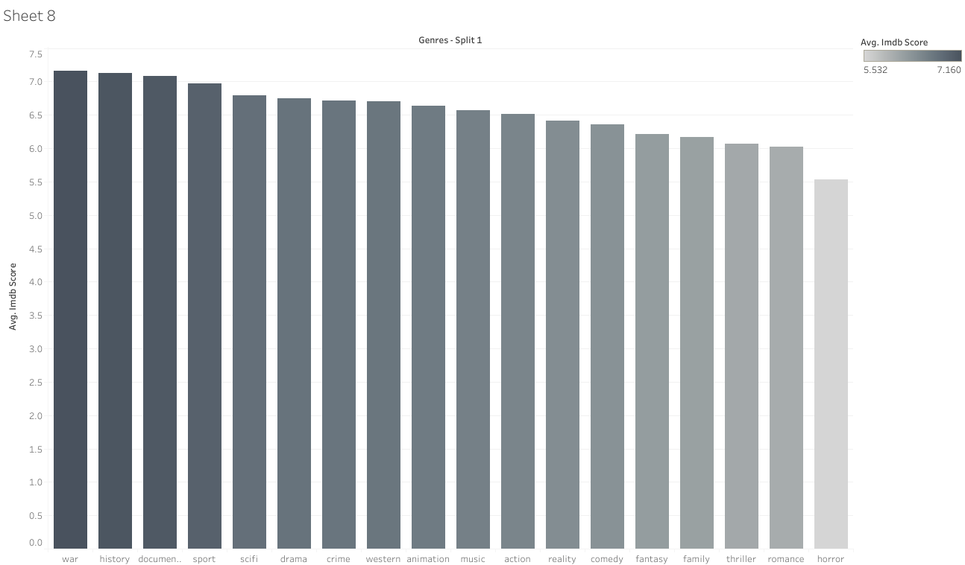
Top Genres
These are the genres on IMDB rated by their average scores
War, history, documentaries are the top 3 scoring genres

Slide 10
Takeaways
TV shows in general are more successful than movies
TV shows with 10-12 seasons are typically your best performers
Longer movies have decent performance
Countries may support the entertainment from their region

